Slide 1
Machine Learning INTERNSHIP 2022

Slide 2
Name : K T SIVA KUMAR
Roll no : 20781A3325
Company Name : INTERNSHALA
Duration : 6 WEEKS
Starting Date : 15/07/2022
Ending Date : 24/08/2022

Slide 3
Project analysing Raw Data set

Slide 4
Problem statement:
Analysis on raw data set and visualization , Which contains information about house selling price regarding to there
Flat size ,Year ,Layout , location , No. of floors.

Slide 5
By using Python libraries
Pandas
It is useful in deploying data of existed files or user Entered provided data.
Pandas is an open source Python package that is most widely used for Data Science / Data analysis and Machine Learning tasks.
Pandas comes with two Data structure for manipulating data :
Series
Data Frames

Slide 6
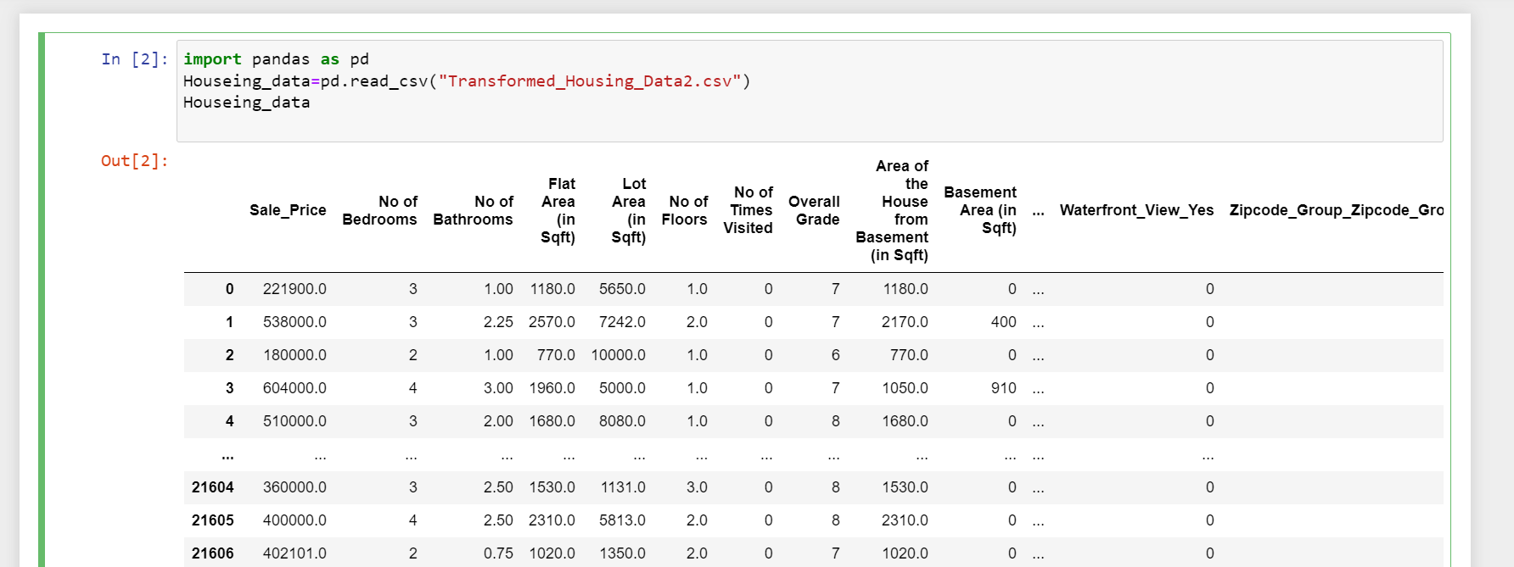
1.First import pandas library to use Housing Data.
Step-1: First import pandas library to use Housing Data.
In the above section , observe that we initialized a CSV File to Houseing _ data variable by using pandas library. It will show the data from beginning to end.

Slide 7
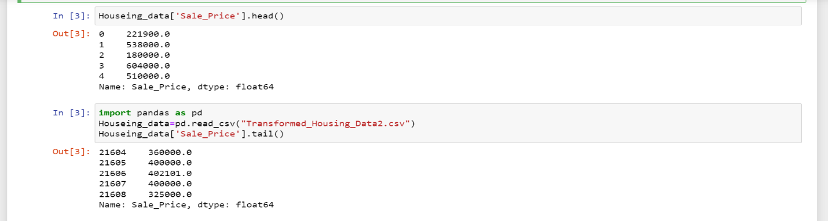
Step-2: To get particular variable data on top list data use head() function , in-front of variable name
Step-3: To get particular variable data of bottom list data use tail() function , in-front of variable name
These functions() helps in getting quick summary of what there top & bottom data , which is easy for Analysis .

Slide 8
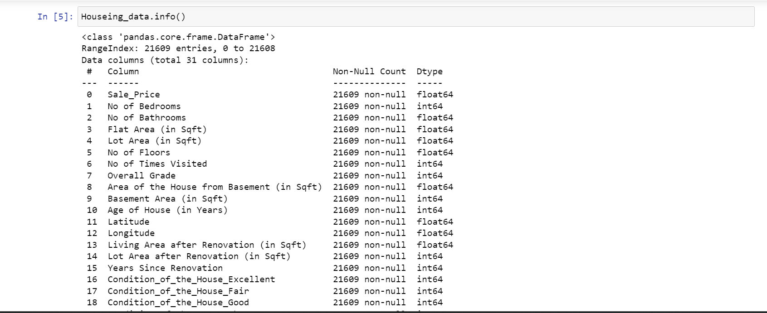
Step-4: By using info() function we will get list of Datatypes in our Housing Data set.
Now we are aware about that what kind of datatypes there in Dataset ,Now we jump into Matplotlib library

Slide 9
MATPLOTLIB
Matplotlib is a low level graph plotting library in python that serves as a visualization utility
Matplotlib was created by John D. Hunter
It is open source

Slide 10
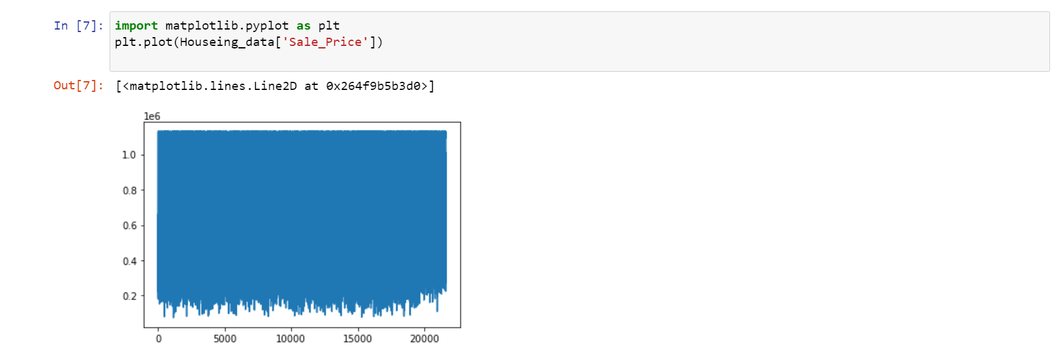
Matplotlib library is used for visual representation of data in graphical manner
Step-5: Now we will plot a line graph for Sale price variable for visual understanding
Here , you can see it plotted a line graph for Sales price.
In next step we will compare two variables difference/change in plotting graph

Slide 11
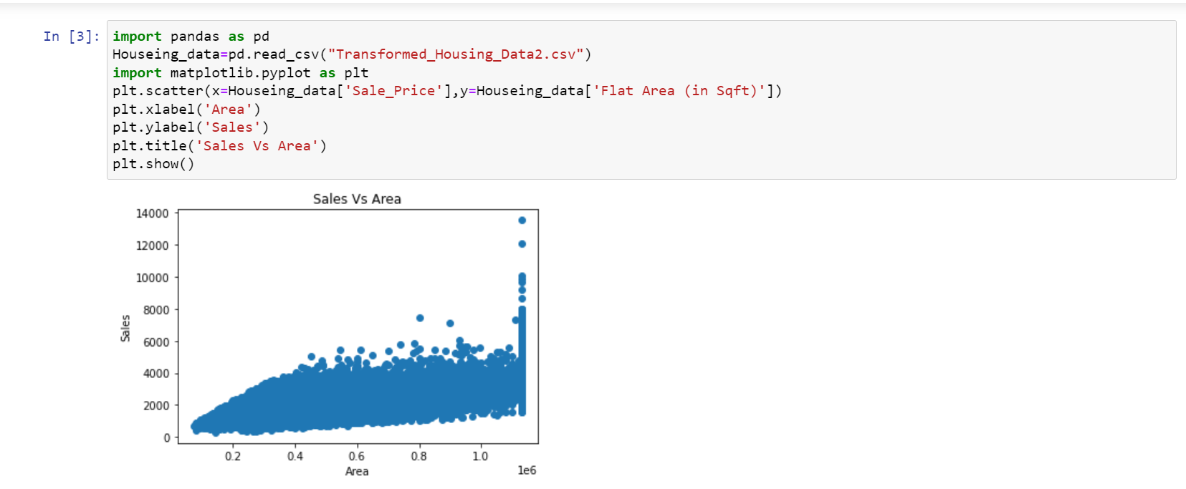
Step-6: Finally we plotted a Scatter plot for Sales price and Flat Area[in sq feet]
By,Using X,Y-Axis , named as Area and Sales
Also compared both values

Slide 12
CONCLUSION:
I believe the trial has shown conclusively that it is both possible and desirable to use Python as the principal teaching language. It is Free (as in both cost and source code). It is trivial to install on a Windows PC allowing students to take their interest further. For 56 many the hurdle of installing a Pascal or C compiler on a Windows machine is either too expensive or too complicated. It can be used to teach a large number of transferable skills. It is a real-world programming language that can be and is used in academia and the commercial world. It appears to be quicker to learn and, in combination with its many libraries, this offers the possibility of more rapid student development allowing the course to be made more challenging and varied and most importantly, its clean syntax offers increased understanding and enjoyment for students. The training program having three destination was a lot more useful than staying at one place throughout the whole 6 weeks. In my opinion. I have gained lots of knowledge and experience needed to be successful in great engineering challenge as in my opinion, Engineering is after all a Challenge, and not a job.

